Slide 1
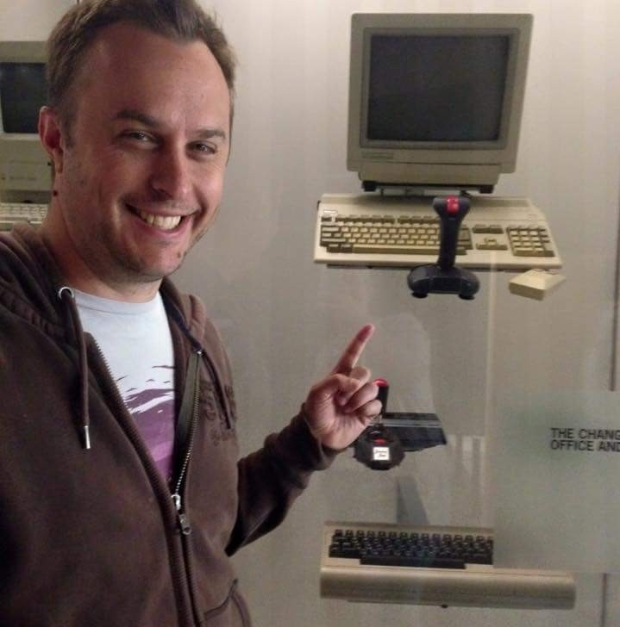
Xamarin - Redux
Andrew Revell
Mobile Developer - Fraedom @llevera & arevell@gmail.com
Notes:
About me

Slide 2
What to expect
Beginner
Developing, building and running a Xamarin Forms MVVM app
Intermediate
Problems with more complex MVVM apps, intro to Redux
Advanced
Considerations when using Redux in a real project
1
2
3

Slide 3
MVVM app
1

Slide 4
MVVM problems
namespace Redux.ViewModels { public class ItemViewModel : BaseViewModel { private readonly Item _item; private readonly ItemsViewModel _itemsViewModel; public ItemViewModel(Item item, ItemsViewModel itemsViewModel) { _item = item; _itemsViewModel = itemsViewModel; } public string Text => _item.Text; public int Quantity { get => _item.Quantity; set { _item.Quantity = value; _itemsViewModel.UpdateSummaries(); OnPropertyChanged(nameof(TextColor)); } } public Color TextColor { get { if (Quantity < 1) return Color.Gray; switch (_item.Category) { case ItemCategory.Fruit: return Color.Orange; case ItemCategory.Vegetable: return Color.Green; case ItemCategory.Meat: return Color.Red; default: return Color.Gray; } } } } }
2
View Models mix
State
State change
UI Mapping
Service calls
Validation
Propagation
State
State change
Propagation
UI Mapping

Slide 5
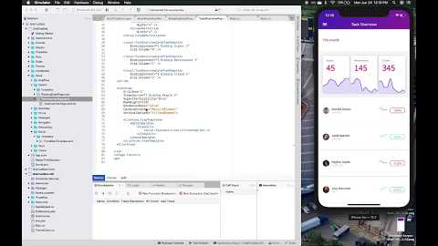
But First!
3
AOT Startup Profiling for Android
AndroidX
Hot Reload

Slide 6
Redux
2
Used with
React
Angular
Flutter
etc

Slide 7
Redux
2

Slide 8
Real considerations
3
Immutability
Performance
Binding work arounds
Error handling

Slide 9
More reading
4
General/JS
https://redux.js.org/
C#
https://medium.com/@to_pe/xamarin-forms-with-redux-part-1-4a3a043cbc41
https://medium.com/pageup-tech/advanced-redux-in-xamarin-part-1-action-creators-19cb257093d2
https://spin.atomicobject.com/2017/03/13/adapting-redux-c-sharp-xamarin/

Slide 10
Presentation Fonts
This template uses the Segoe UI font. It’s included on Windows but most be downloaded and installed (just open it) on OS X:
Download here:
http://bit.ly/22vaiZ8
Section heading
Bold 180pt.
Title copy
Bold 80pt.
Subheading
Light 60pt.
Body copy
Regular 54pt.

Slide 11
Presentation Fonts
This template uses the Segoe UI font. It’s included on Windows but most be downloaded and installed (just open it) on OS X:
Download here:
http://bit.ly/22vaiZ8
Section heading
Bold 180pt.
Title copy
Bold 80pt.
Subheading
Light 60pt.
Body copy
Regular 54pt.

Slide 12
Presentation Fonts
This template uses the Segoe UI font. It’s included on Windows but most be downloaded and installed (just open it) on OS X:
Download here:
http://bit.ly/22vaiZ8
Section heading
Bold 180pt.
Title copy
Bold 80pt.
Subheading
Light 60pt.
Body copy
Regular 54pt.

Slide 13
Code representation example
public override void OnViewCreated (View view, Bundle savedInstanceState) { base.OnViewCreated (view, savedInstanceState);
ListView.DividerHeight = 0; ListView.Divider = null; ListAdapter = new GroceryListAdapter (view.Context, _order.Products);
if (ListAdapter.Count == 0) { checkoutButton.Visibility = ViewStates.Invisible;
} }

Slide 14
Use separate slides to call out sub-snippets
public override void OnViewCreated (View view, Bundle savedInstanceState) { base.OnViewCreated (view, savedInstanceState);
ListView.DividerHeight = 0; ListView.Divider = null; ListAdapter = new GroceryListAdapter (view.Context, _order.Products);
if (ListAdapter.Count == 0) { checkoutButton.Visibility = ViewStates.Invisible;
} }

Slide 15
Evolve 2016 color palette
Template
Life cycle
Build
Test
R:118 G:130 B:138
HEX: 76828A
R:79 G:202 B:230
HEX: 4FCAE6
R:29 G:174 B:206
HEX: 1DAECE
R:54 G:82 B:113
HEX: 365271
R:245 G:109 B:80
HEX: F56D50
R:122 G:213 B:201
HEX: 7AD5C9
Monitor
Accelerate/Learn
R:124 G:105 B:174
HEX: 7C69AE
R:240 G:178 B:63
HEX: 7C69AE
R:147 G:120 B:205
HEX: 9378CD
R:184 G:231 B:123
HEX: B8E77B
Notes:
Put lifecycle titles in quotes

Slide 16
Iconography
Please use the outlined device icons provided here for any iconography needs in your presentation. Resize, copy and paste as needed.

Slide 17
Building blocks
Copy and paste as needed. Hold down the shift key while clicking and dragging the shape from the corner to resize it proportionally.

Slide 18
Chart example: vertical
1
Eliminate qualifiers that contradict the device configuration
2
Identify the next qualifier in the table (MCC first, then MNC, then language, and so on)
3
Do any resource directories use this qualifier?
No
Continue until only one directory for the desired resource is left
5
Yes
4
Eliminate directories that do not include this qualifier
If the qualifier is screen density, the system selects the “best match” and the process is done.
Notes:
Add 2/3 circles aligned in a row on a separate slide.

Slide 19
Chart example: horizontal
CustomRender
Portable class library
CustomRender.iOS
CustomRender.Droid
CustomRender.WinPhone
MyEntryRenderer
MyEntryRenderer
MyEntryRenderer
App
EntryRenderer
EntryRenderer
EntryRenderer
MainPage
Xamarin.iOS SDK assemblies
Xamarin.Android SDK assemblies
Windows Phone SDK assemblies
MyEntry
Notes:
Add 2/3 circles aligned in a row on a separate slide.

Slide 20
Chart elements
The shapes below can be copied and pasted for use in building charts.
1
2
3
4
5
6
7
8

Slide 21
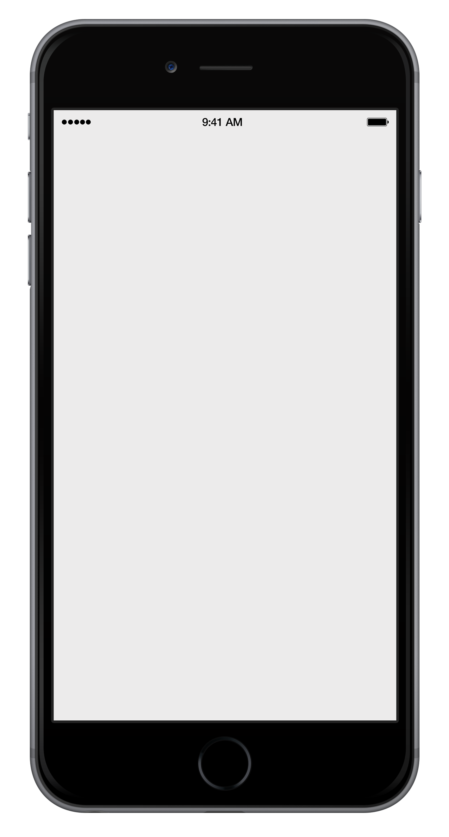
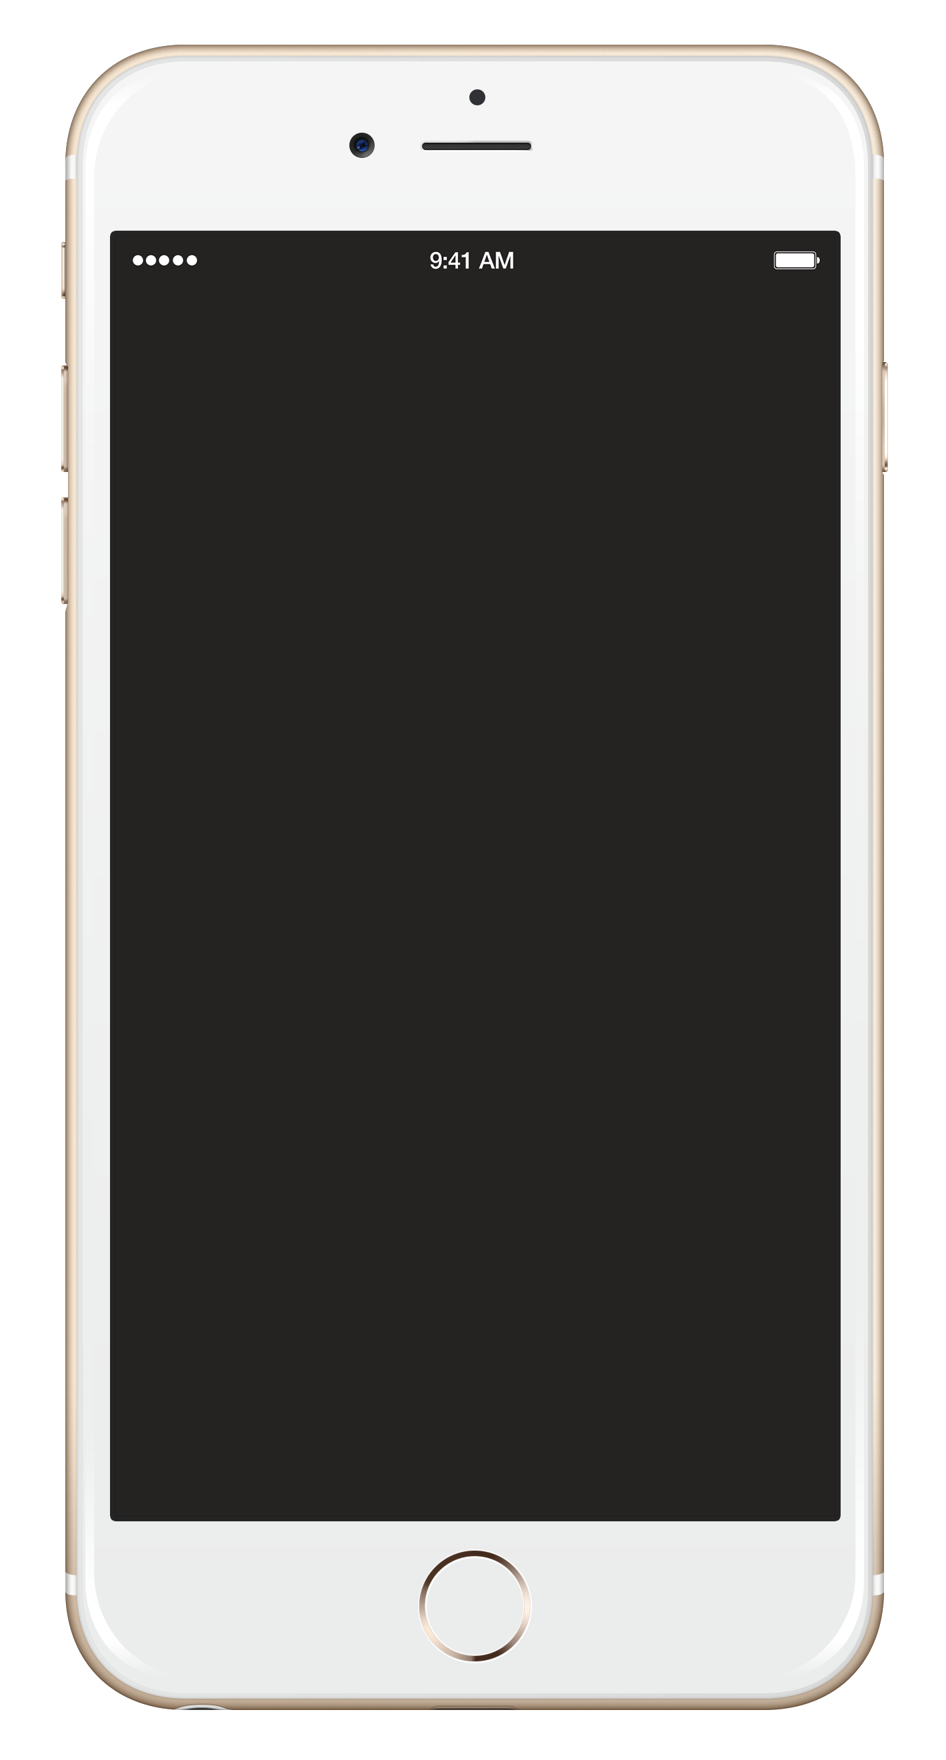

Device frames
iPhone 6s/6s Plus

Slide 22
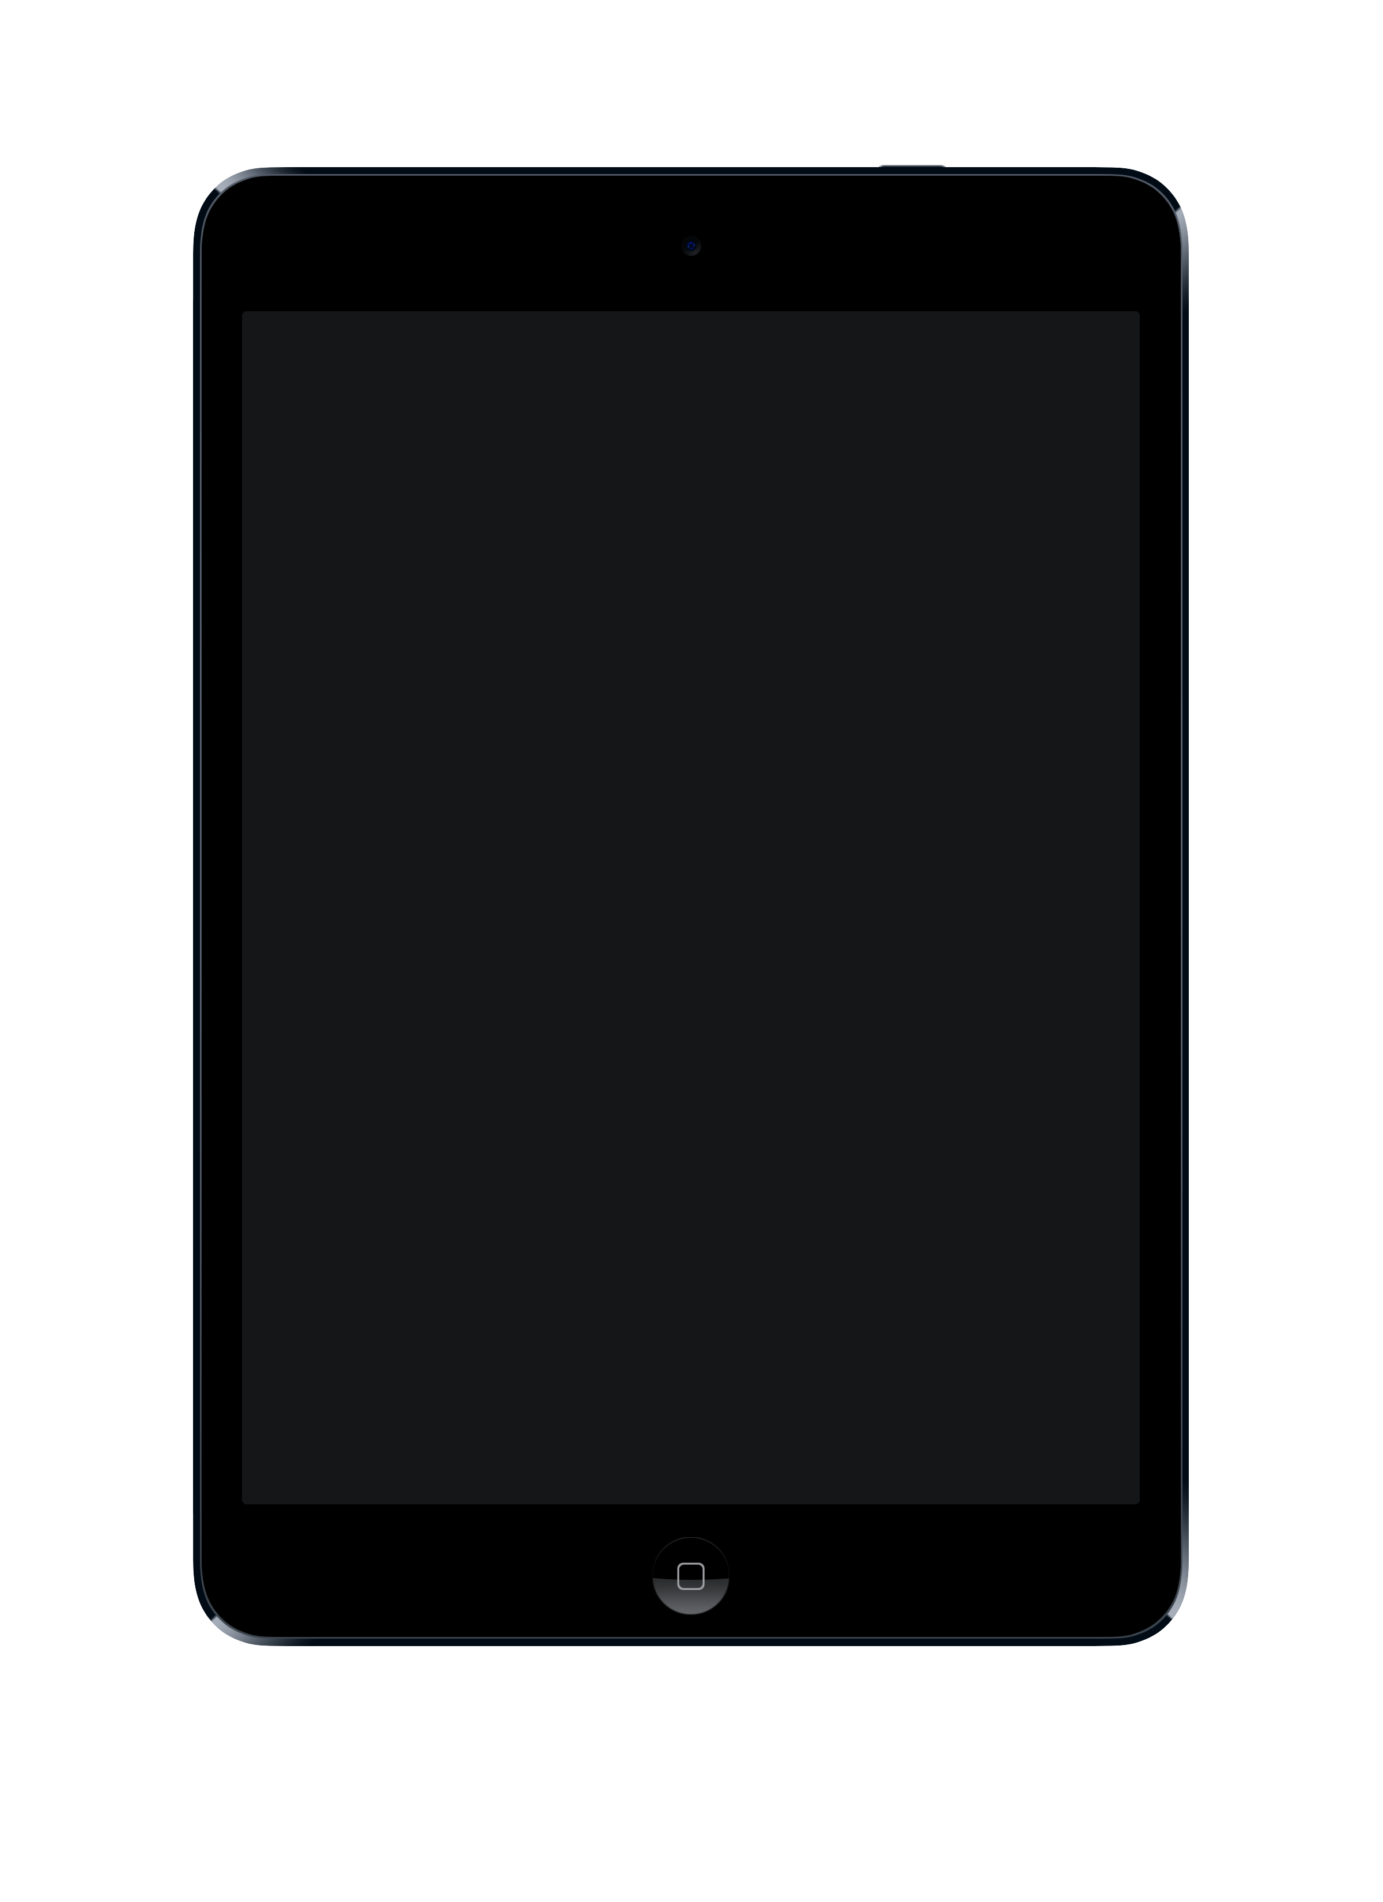
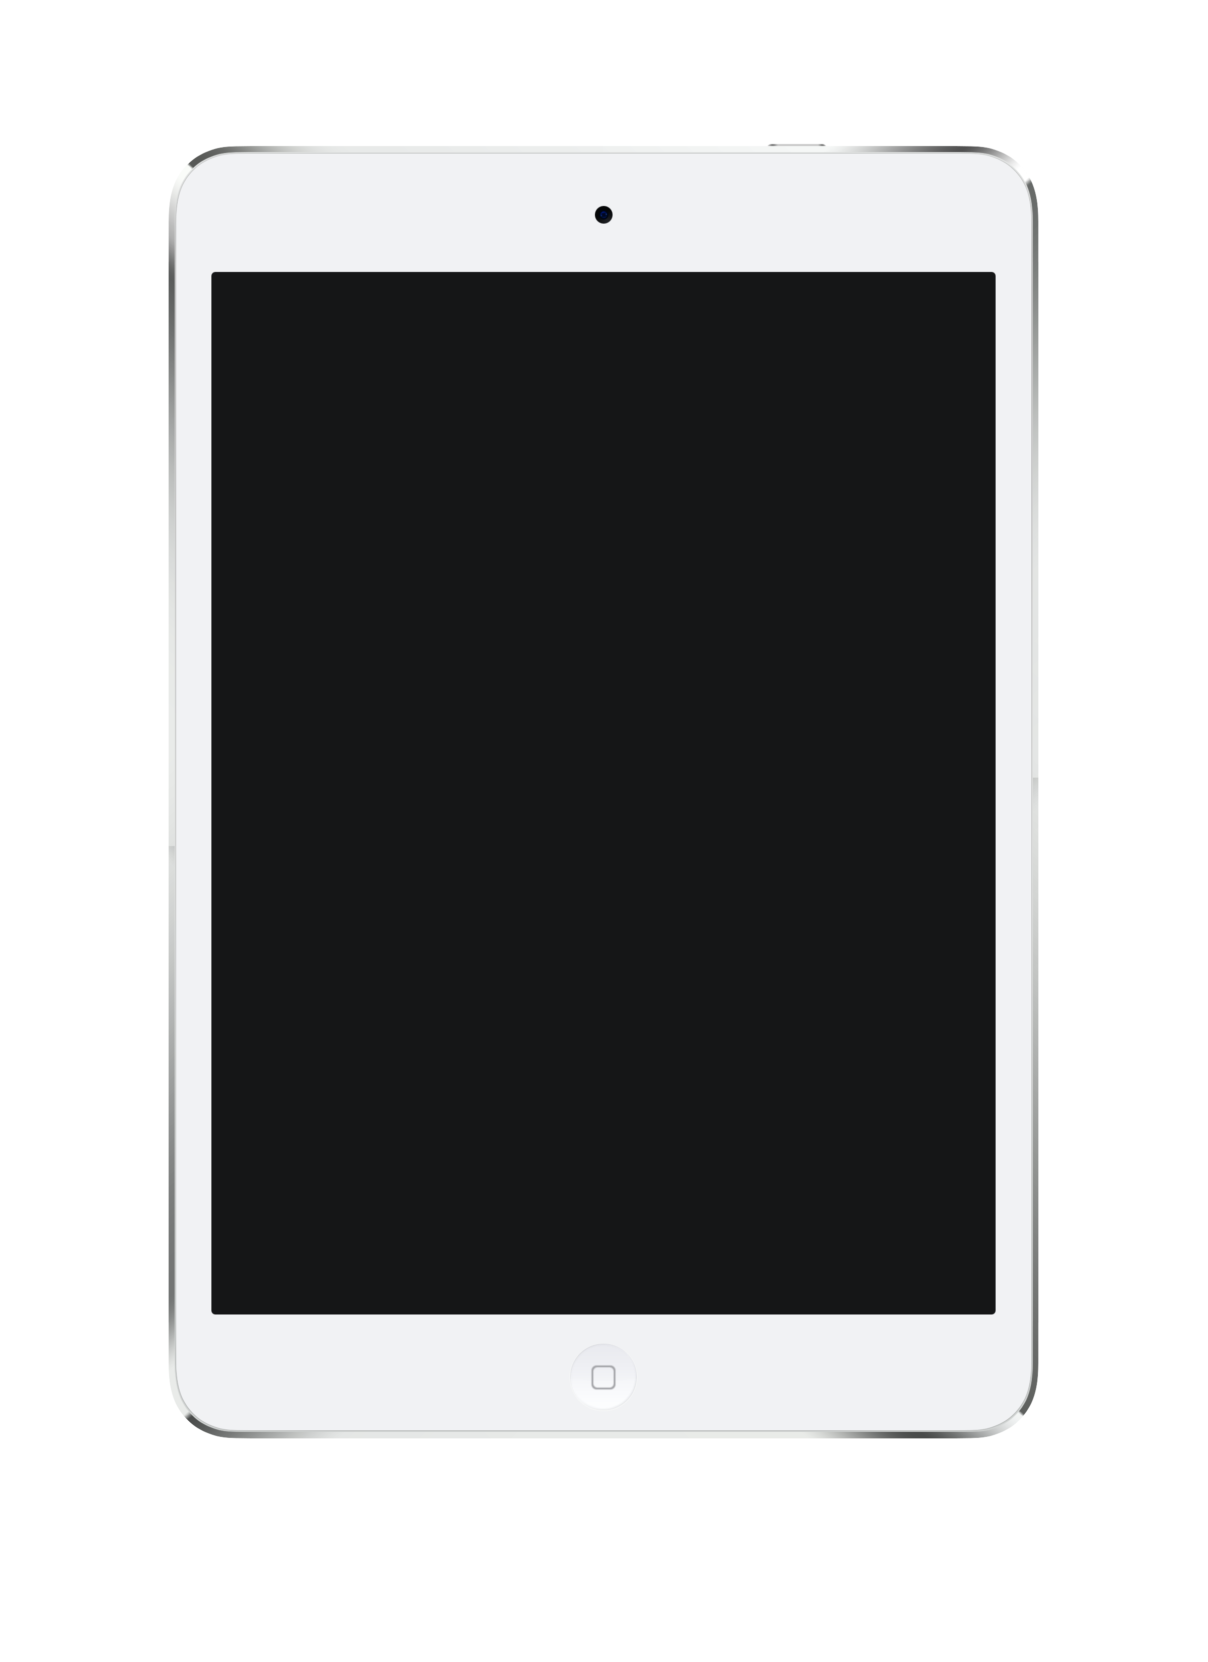
Device frames
iPad

Slide 23

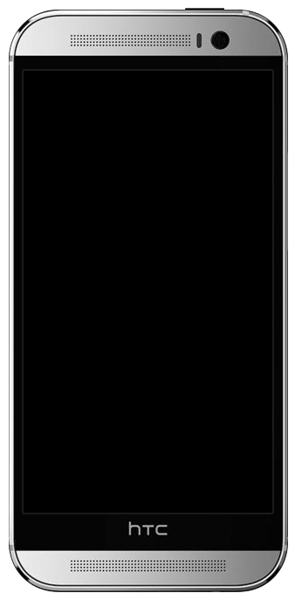
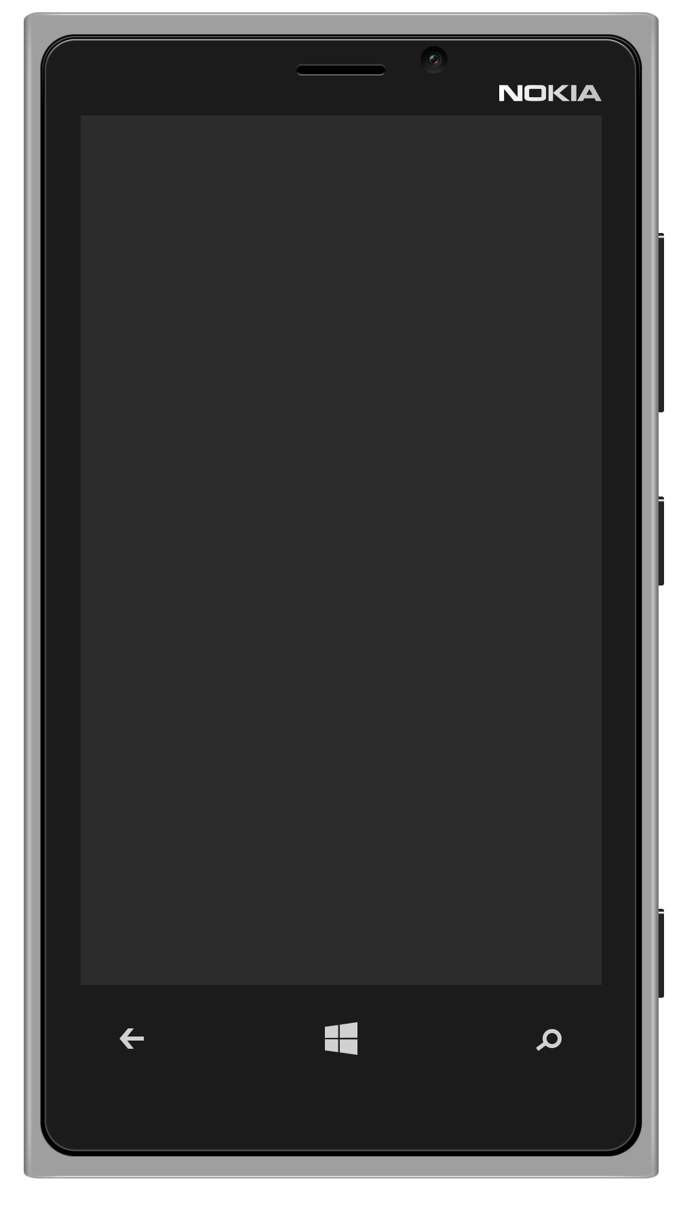
Device frames
Nexus
HTC
Nokia

Slide 24

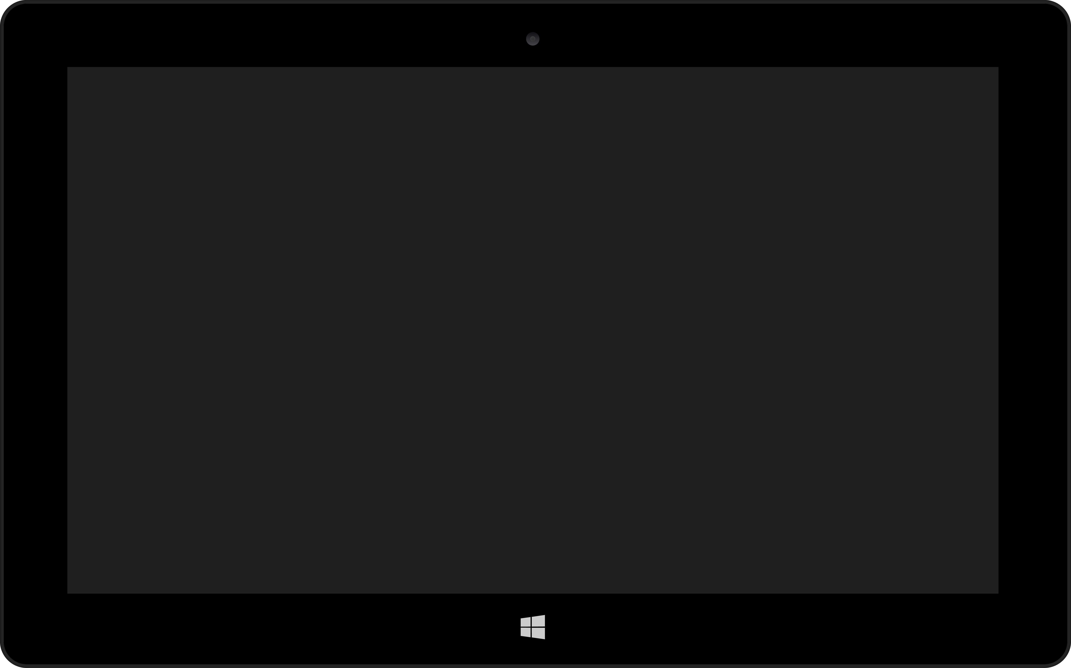
Device frames
Microsoft Surface
Nexus 10
Notes:
Get Nexus 9 (find laptop frames)

Slide 25
Using quality images
The difference between good quality images and poor quality images speaks volumes in your presentation. Use only high resolution imagery for a clean and professional looking deck.
If you scale your images up and they pixelate like the example on the right, source a higher quality image.
High resolution
Low resolution

Slide 26
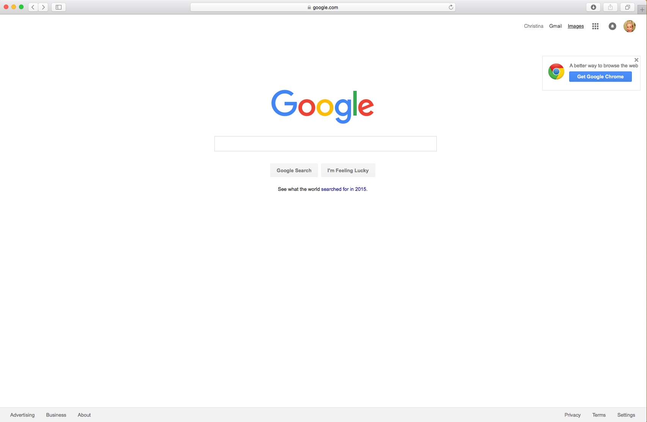
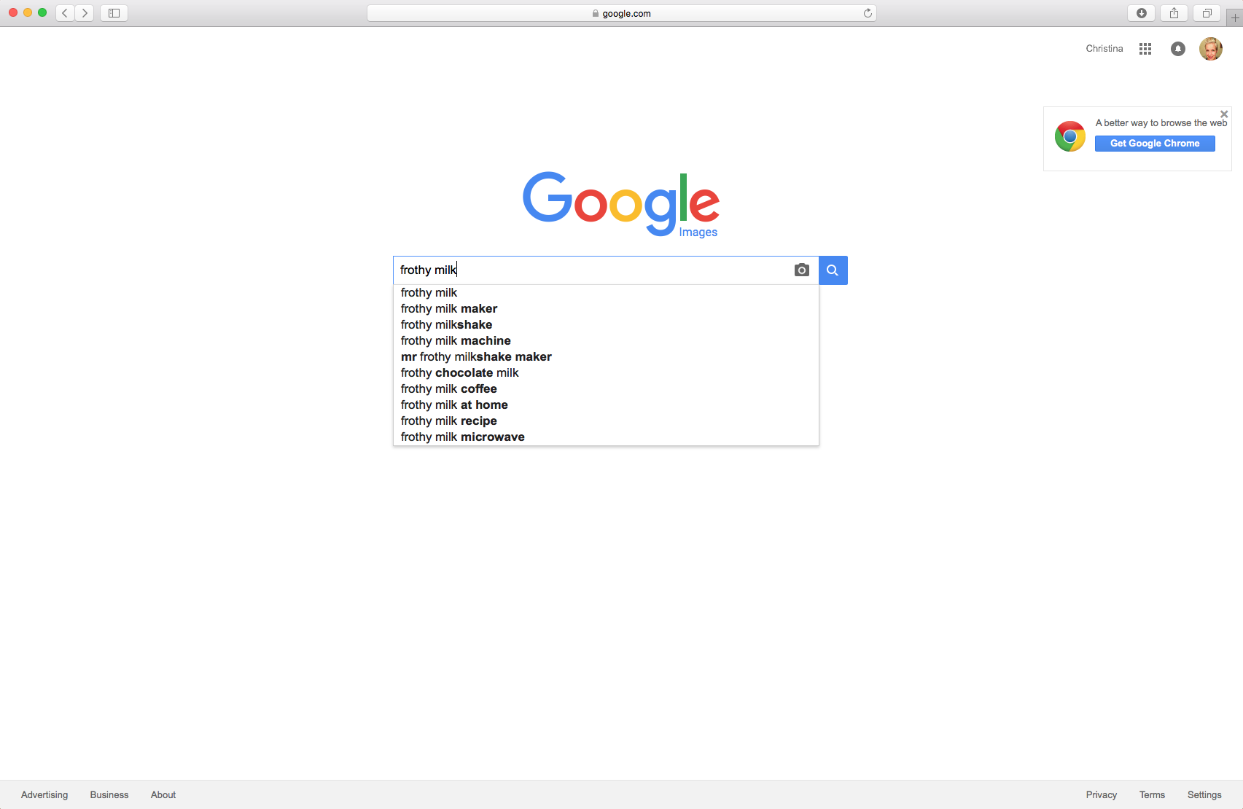
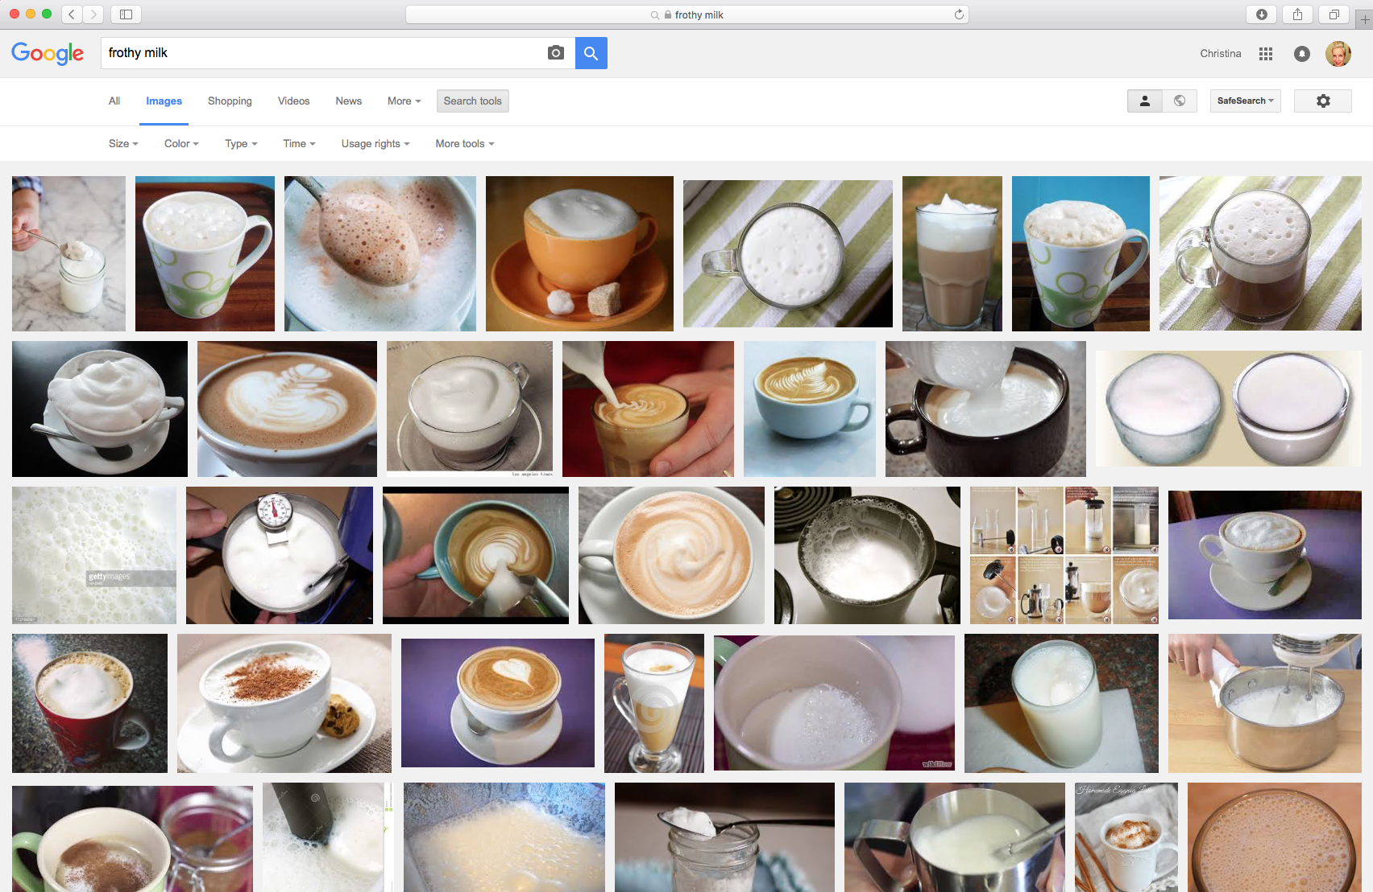
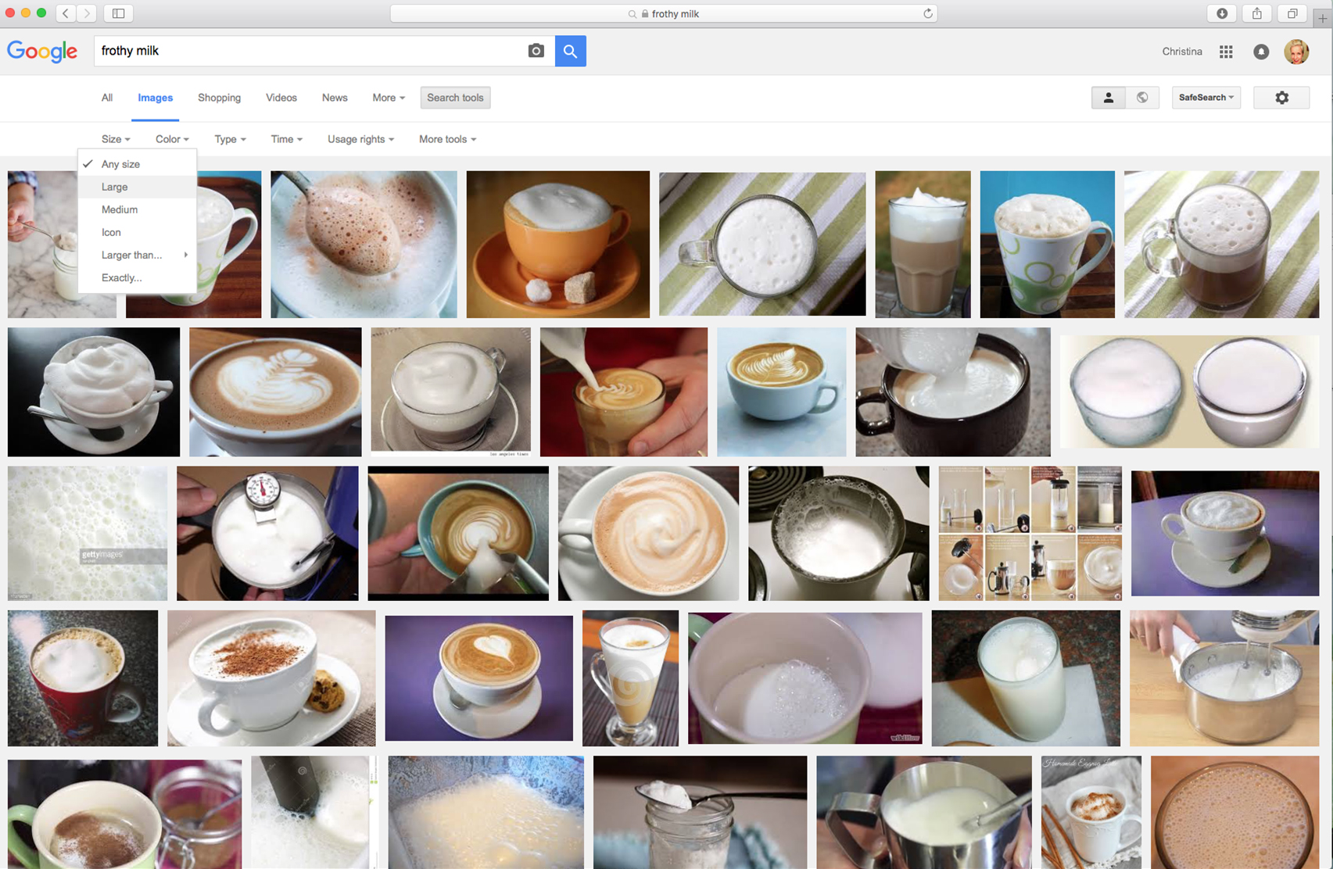
Finding good quality images
Select “Images”
When looking for images online, follow the process to the right to source the highest resolution images to use in your presentation.
Alternatively, seek out freestock sites such as: pexels.com for good, high quality free imagery.
Type in your image search criteria
Click “Search tools”
Select “Large”

Slide 27
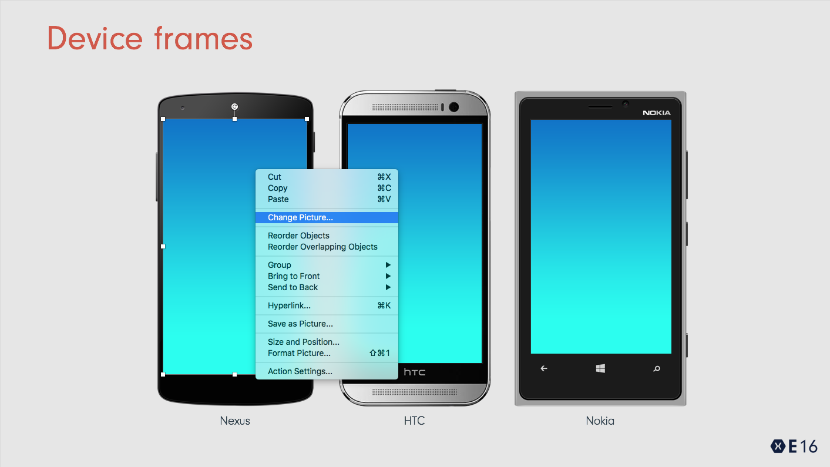
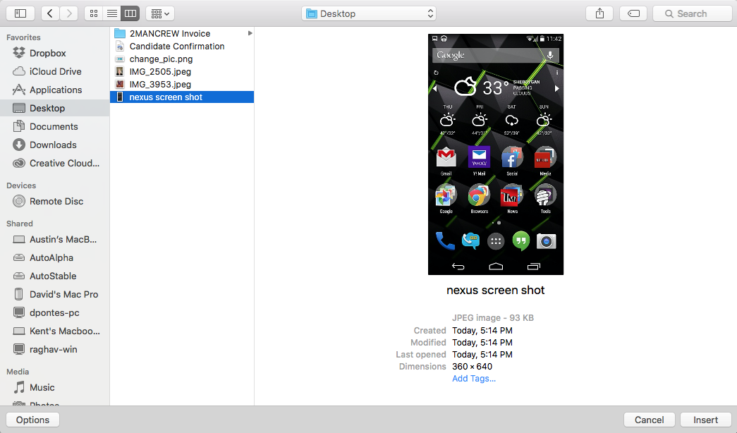
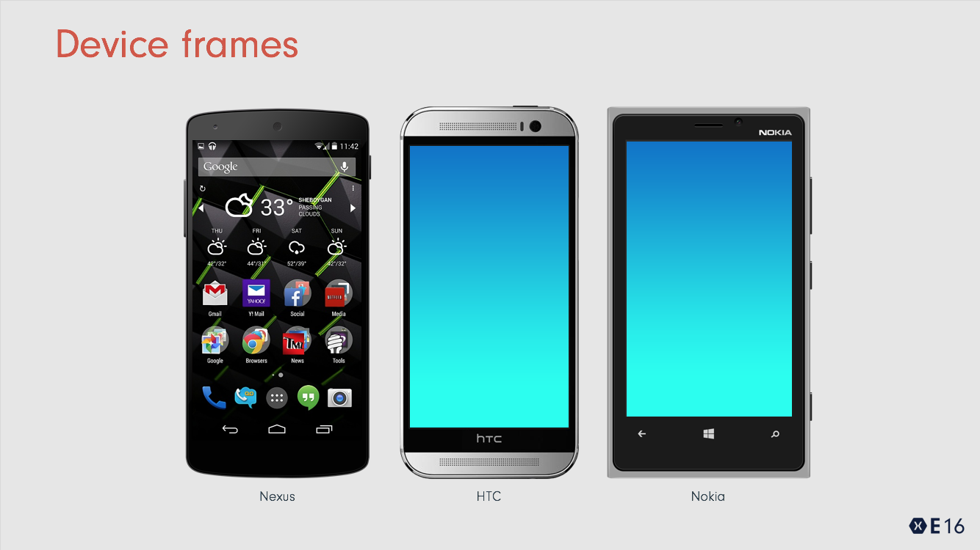
Replacing images in devices
Right click on the placeholder gradient image in the device and select “Change picture” as shown.
This will open a finder window for you to navigate to the screenshot you want to use in the device.
Select your screenshot and click on the “Insert” button in the lower right.
*Note, screen shots must be the correct dimensions for the device. Screens work best when you capture the image on the appropriate device.

Slide 28
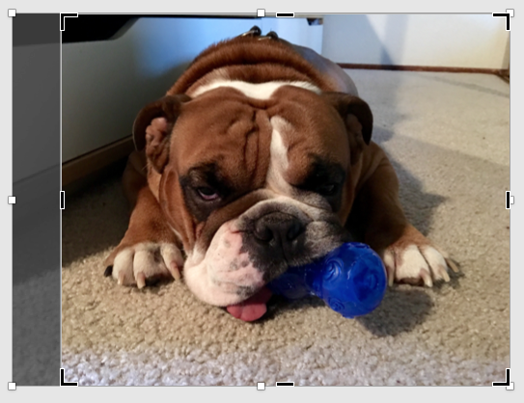
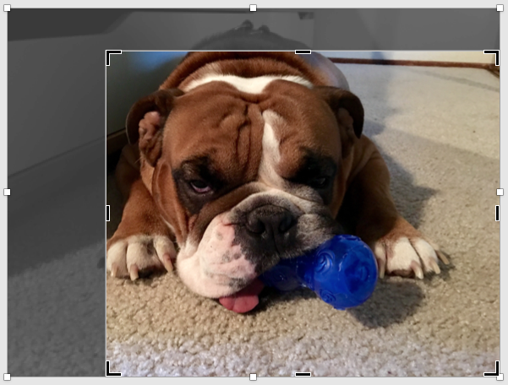
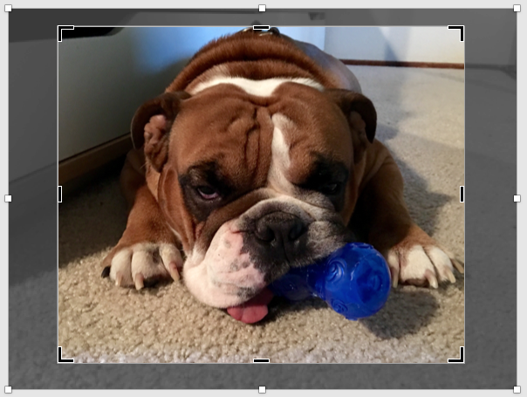
Cropping images
Click on the image and navigate to the “Picture Format” tab.
Select “Crop” from the formatting options
Crop your picture by grabbing the black handles on any side of the image.
You can also resize/reposition the image within the cropped area by grabbing a corner of the image or clicking on it and moving it to the desired position.
Image crop handles
Grab corners to size image proportionally
Image resizing handles

Slide 29
Test cloud and games
James Clancy Xamarin @James

Slide 30

Test cloud and games
James Clancy Xamarin @James

Slide 31
Test cloud and games
James Clancy Xamarin @James

Slide 32
I want to test games!

Slide 33

Locale settings

Slide 34
Why?
Poor return on investment
Pixel Detection
Play and Record
Physics
AI

Slide 35
Why?
Poor return on investment
Pixel Detection
Play and Record
Physics
AI
Game developer responses
Deadlines
You can’t write test for X
Games are too big
Lack of tooling
Game developers are hardcore

